Slide 1
DIABETES PREDICTION SYSTEM
JAWAD HASSAN
2230-0035
BS AI

Slide 2
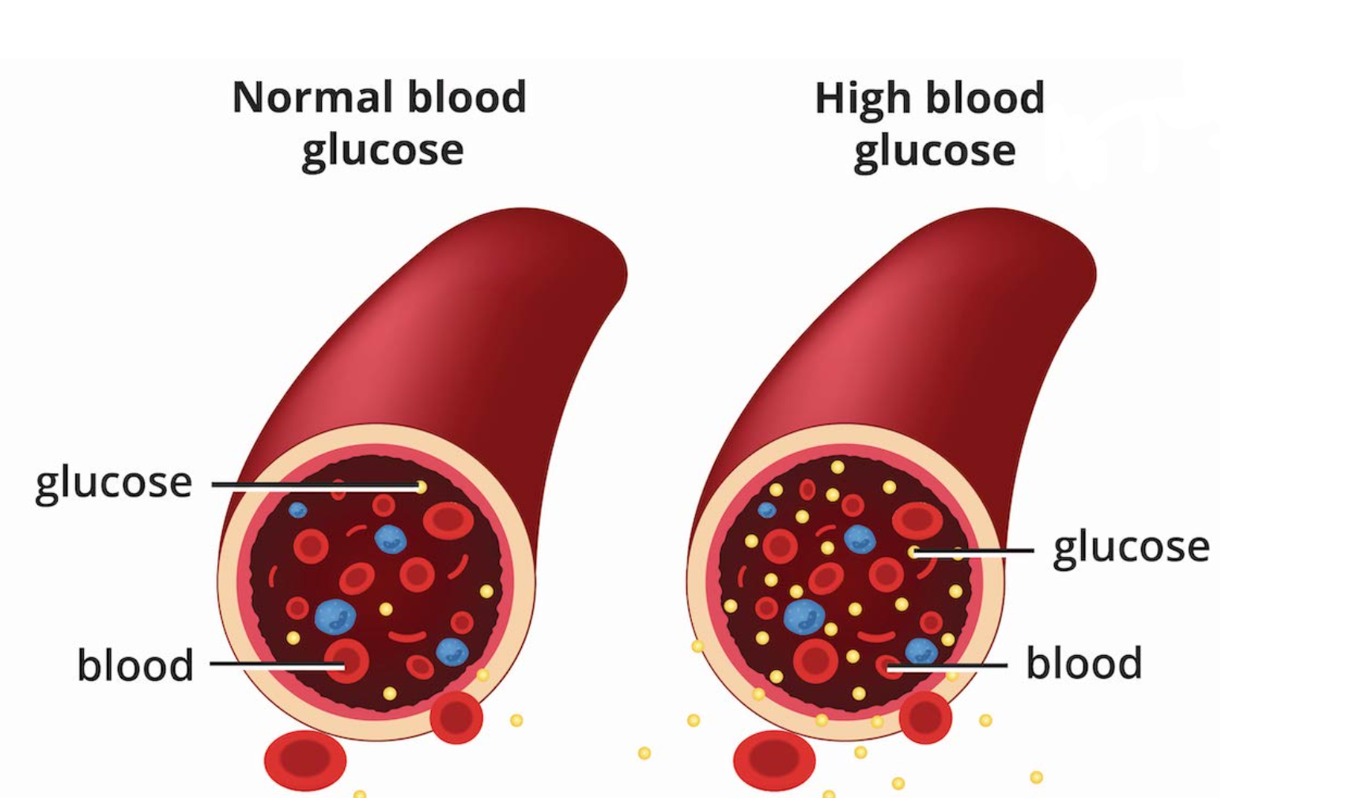
BACKGROUND

Slide 3
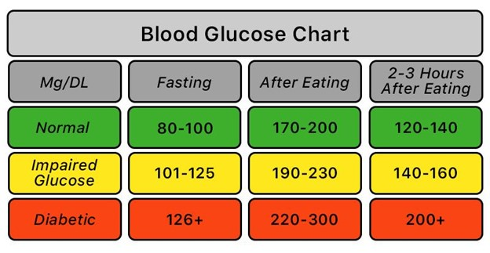
TABLE PREDIABETIC & TYPE 2

Slide 4
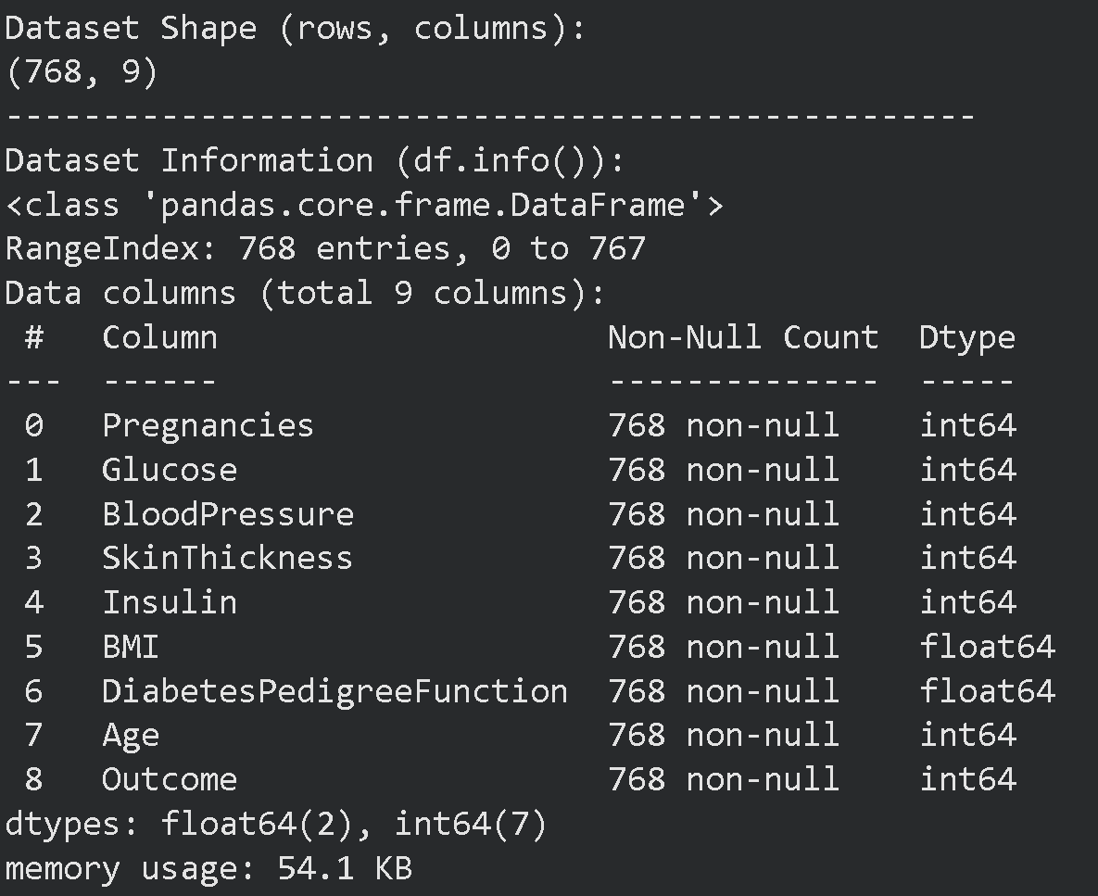
Exploratory Data Analysis

Slide 5
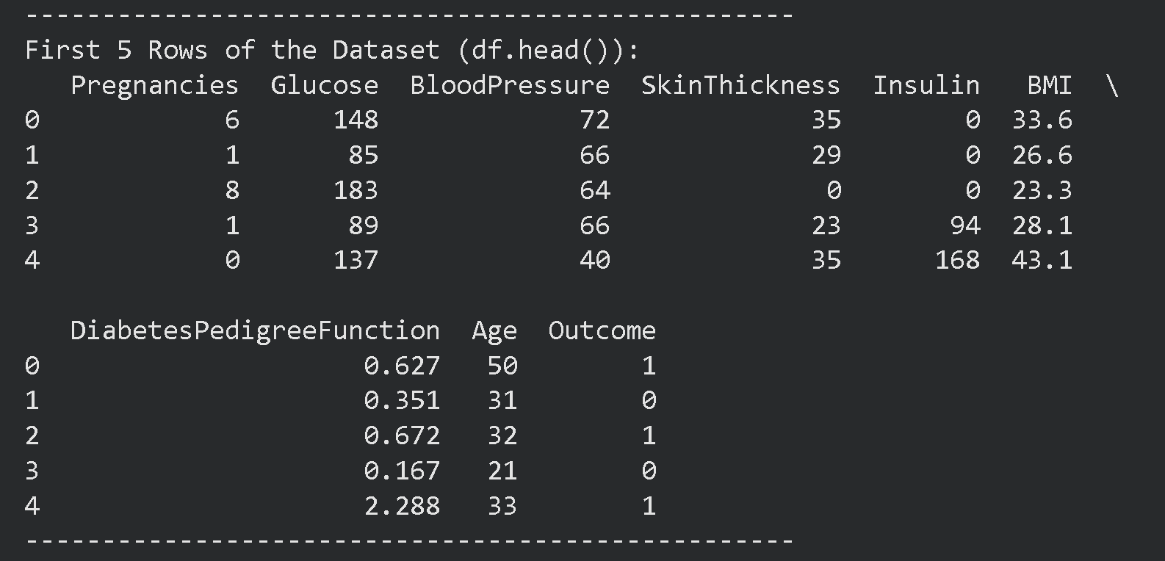
HEAD

Slide 6
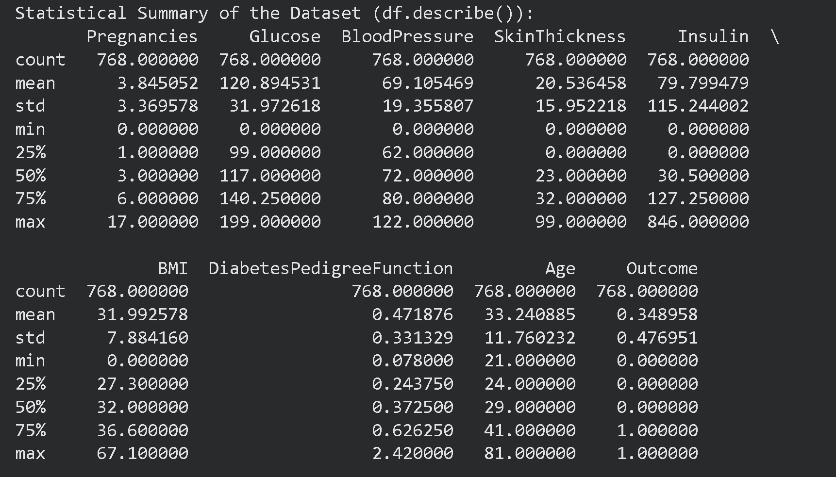
SUMMARY

Slide 7
NATURE OF DATA
768 non-null
int64 → 7 columns
float64 → 2 columns
Target variable Outcome is a binary variable
0 ->Non-diabetic (500)
1->Diabetic (268)
Problem is a binary classification task.
Continuous Numerical features + Categorical target

Slide 8
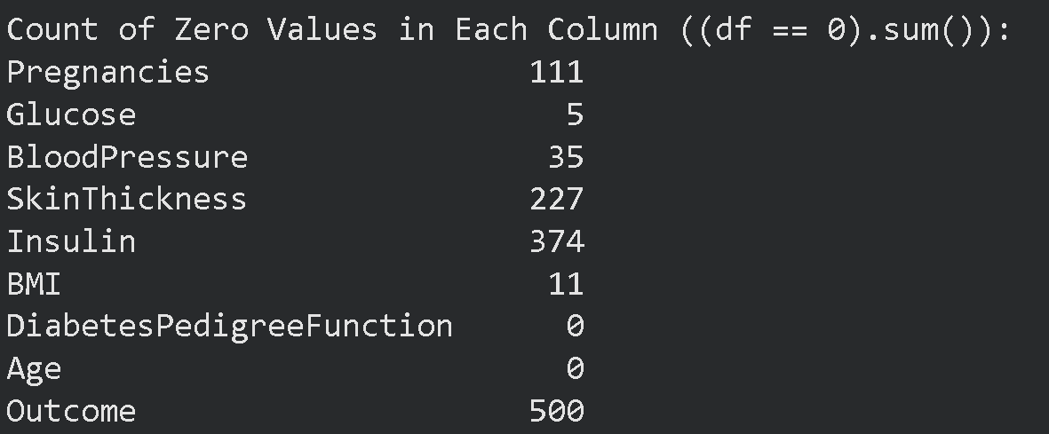
CRITICAL CHALLENGES
Class Imbalance
Distribution
Class 0 -> 65%
Class 1 -> 35%
Model favors majority class
Zero values in medical features (BMI,BP,Glucose)
Insulin = 0 → not physiologically possible
Skin Thickness = 0 → invalid measurement
Represent missing values

Slide 9
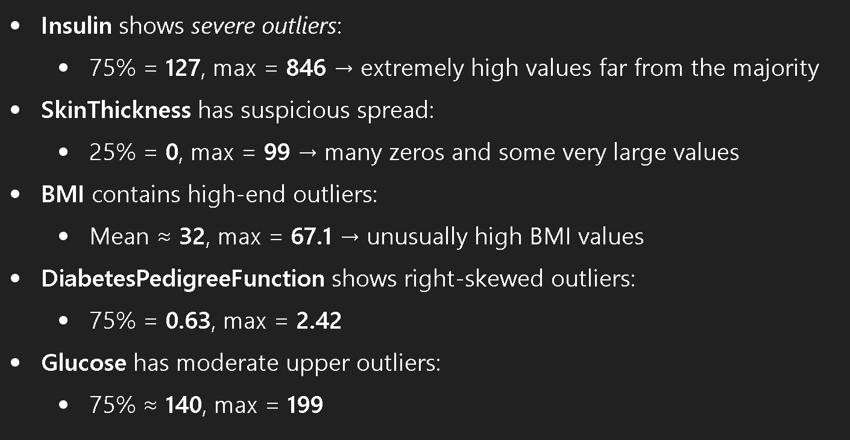
POTENTIAL OUTLIERS

Slide 10
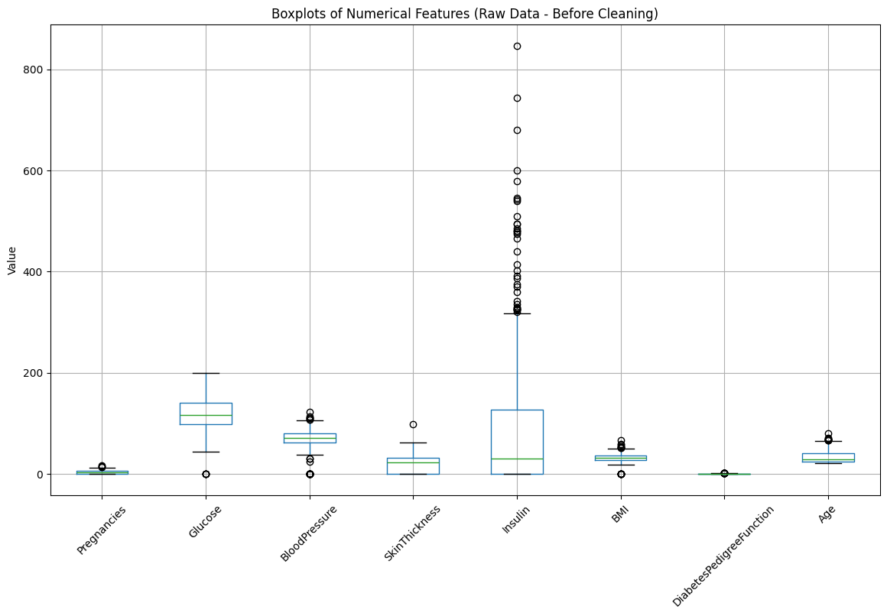
VISUALIZE RAW DATA

Slide 11
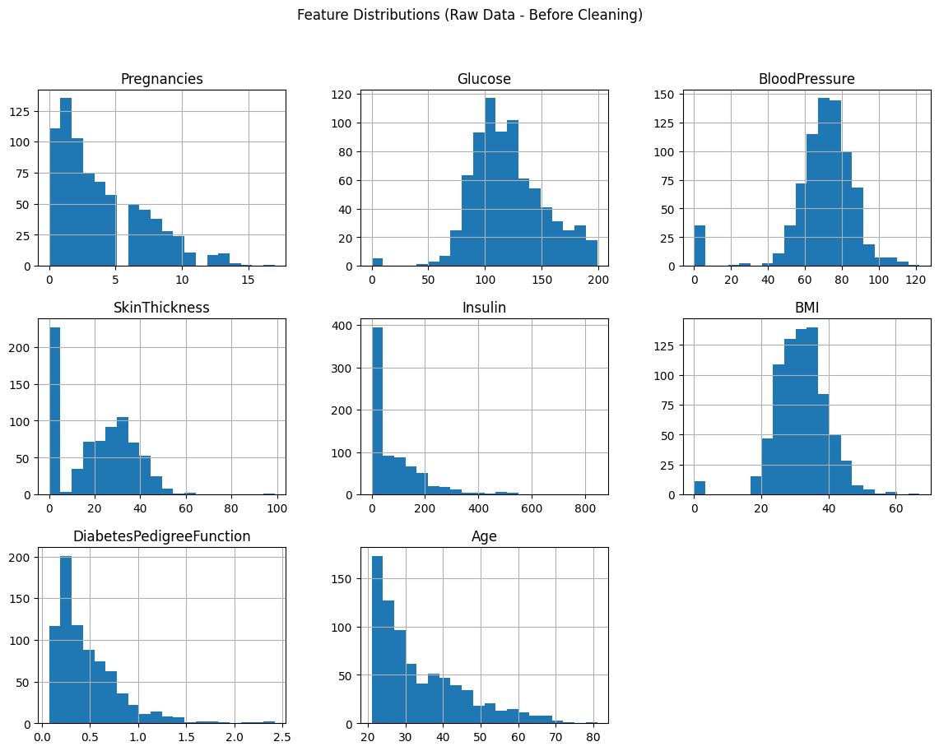

Slide 12
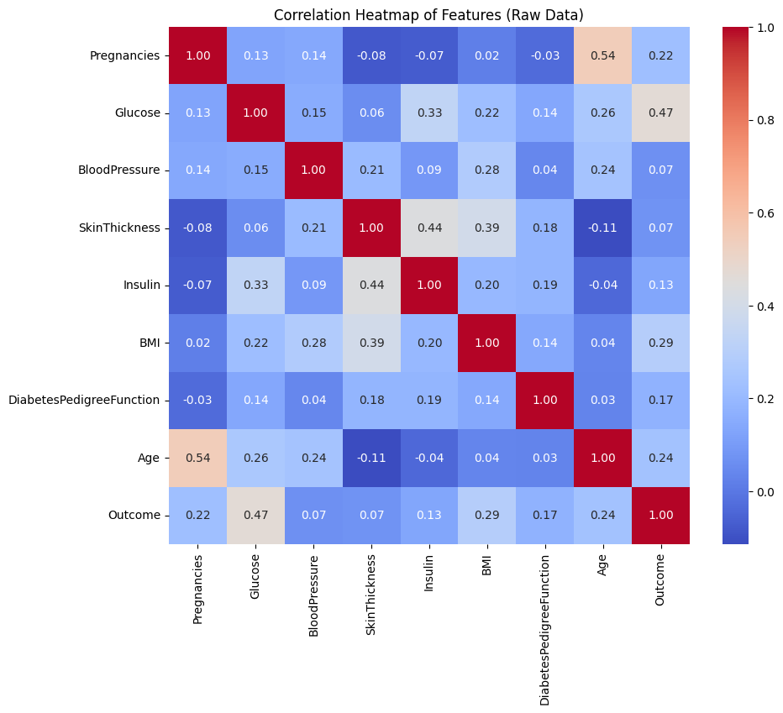

Slide 13
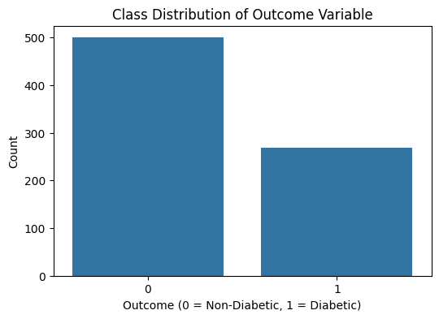

Slide 14
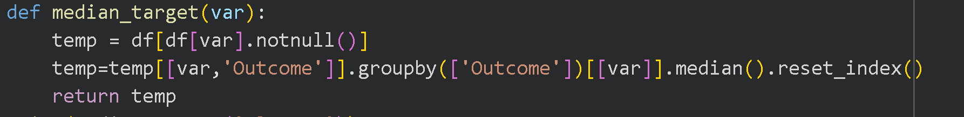
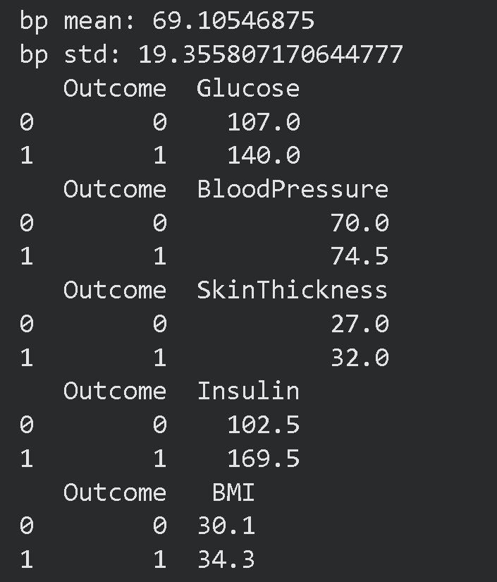
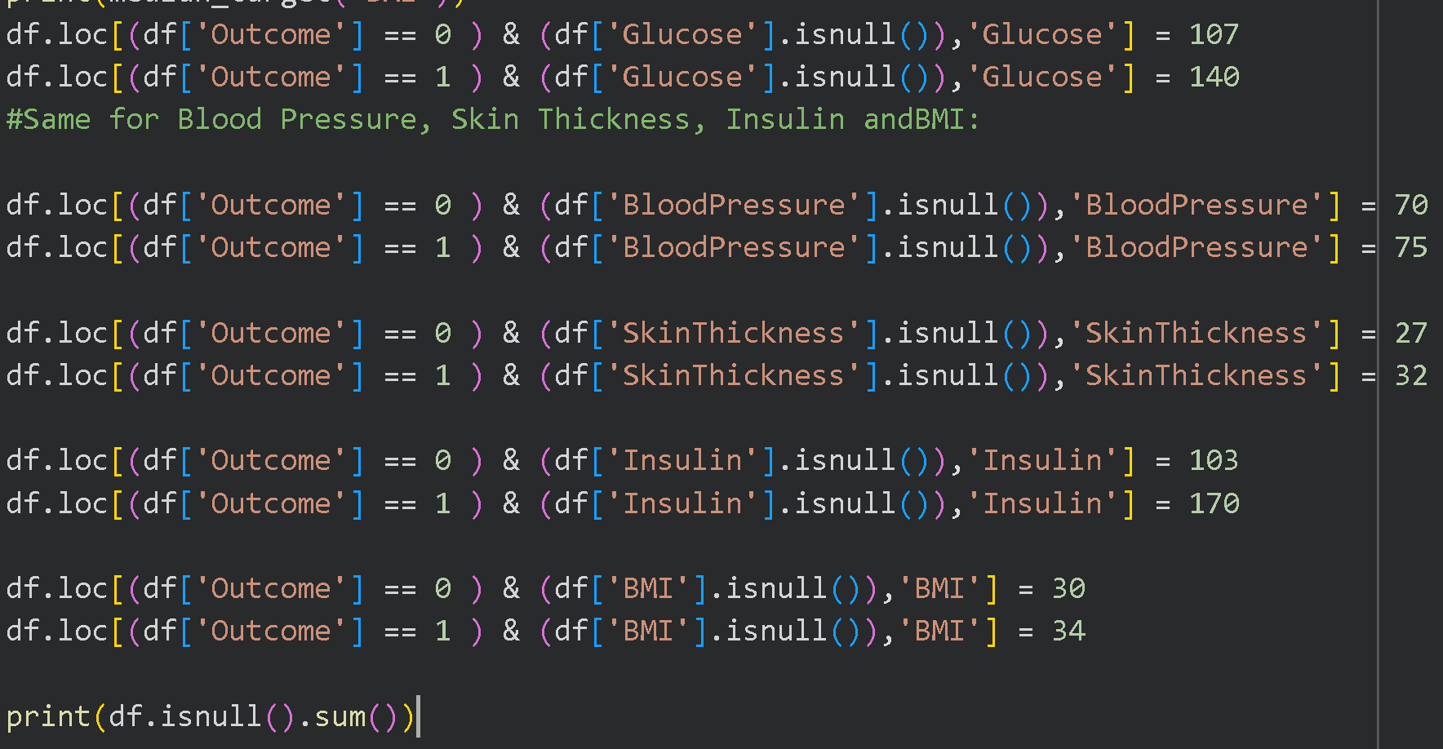
DATA PREPROCESS TARGET IMPUTATION

Slide 15
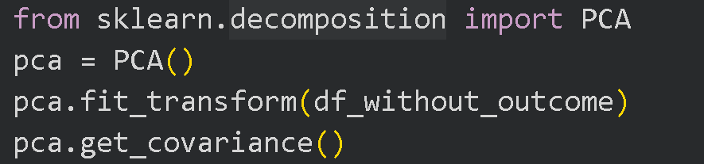
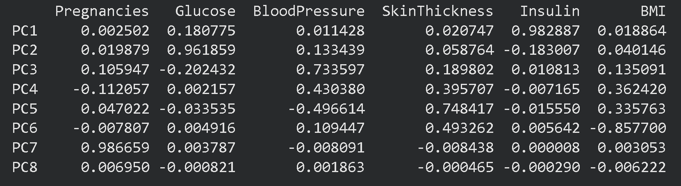
PRINCIPAL COMPONENT ANALYSIS

Slide 16
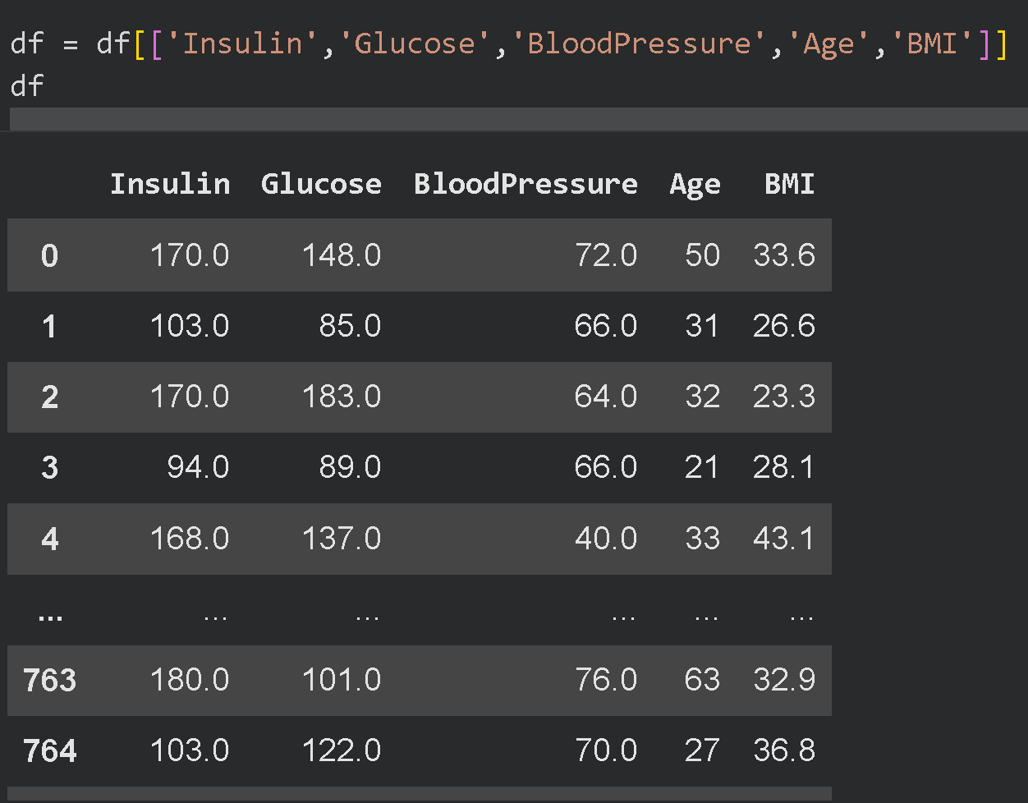
FEATURE DROP

Slide 17
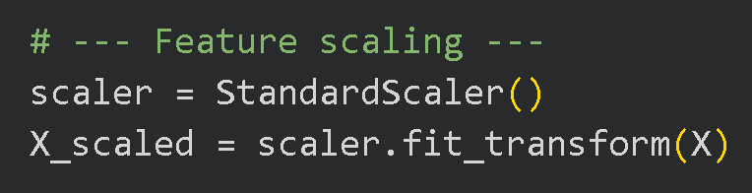
FEATURE SCALING
TRAIN TEST SPLIT

Slide 18
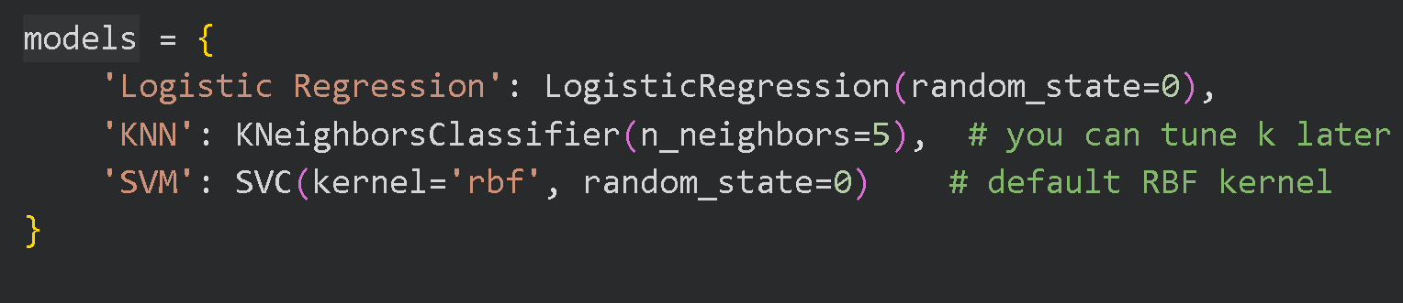
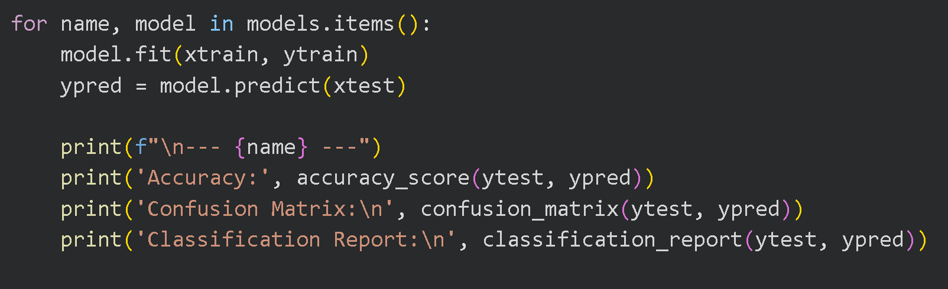
MODEL TRAINING

Slide 19
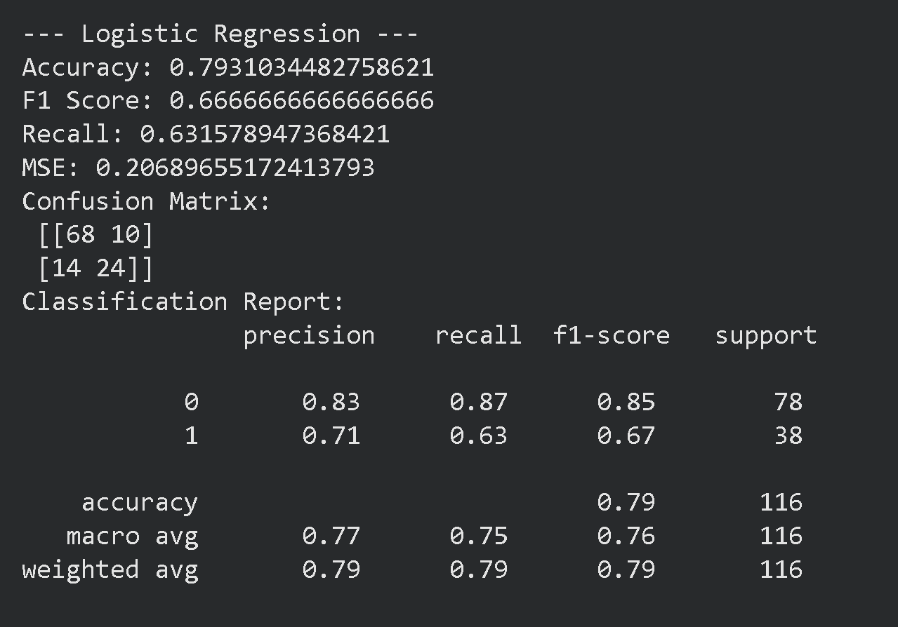
LOGISTIC REGRESSION

Slide 20
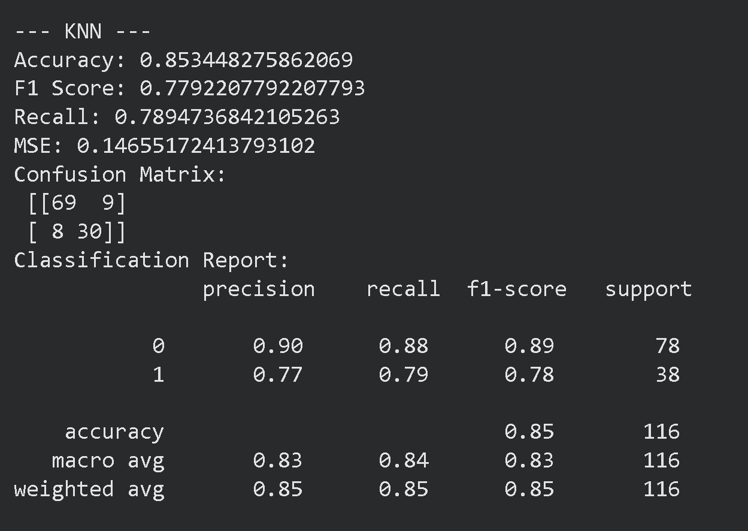
KNN

Slide 21
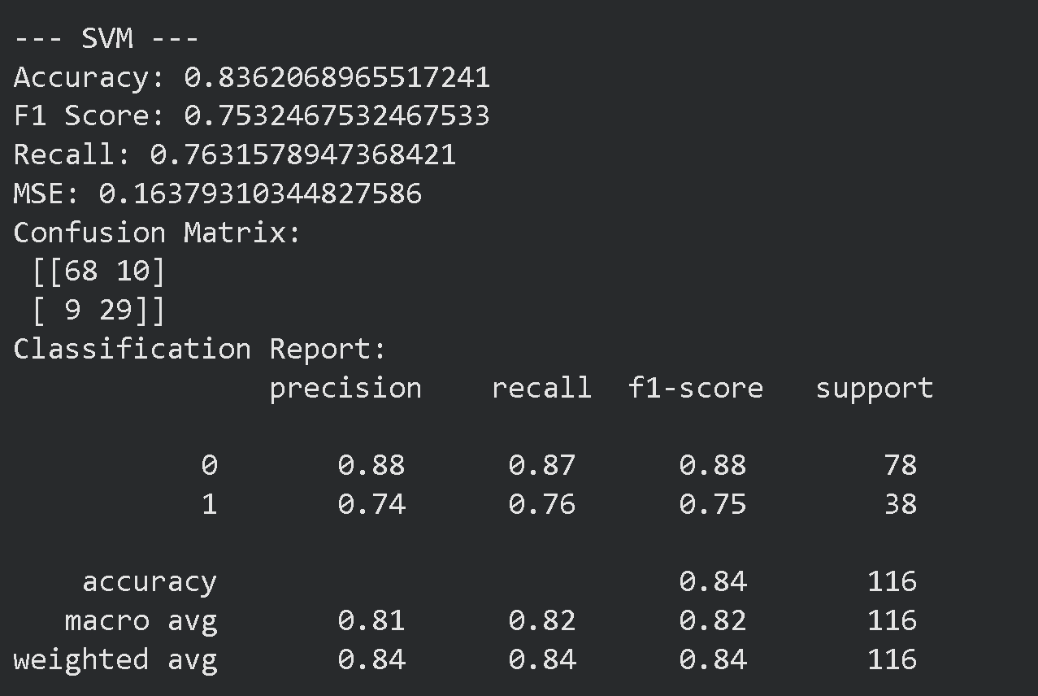
SVM

Slide 22
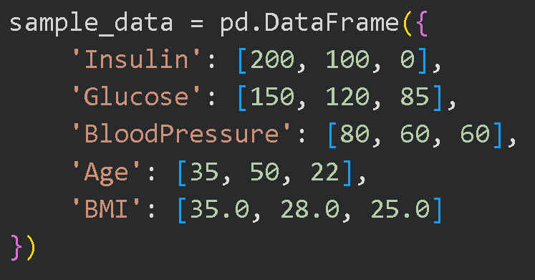
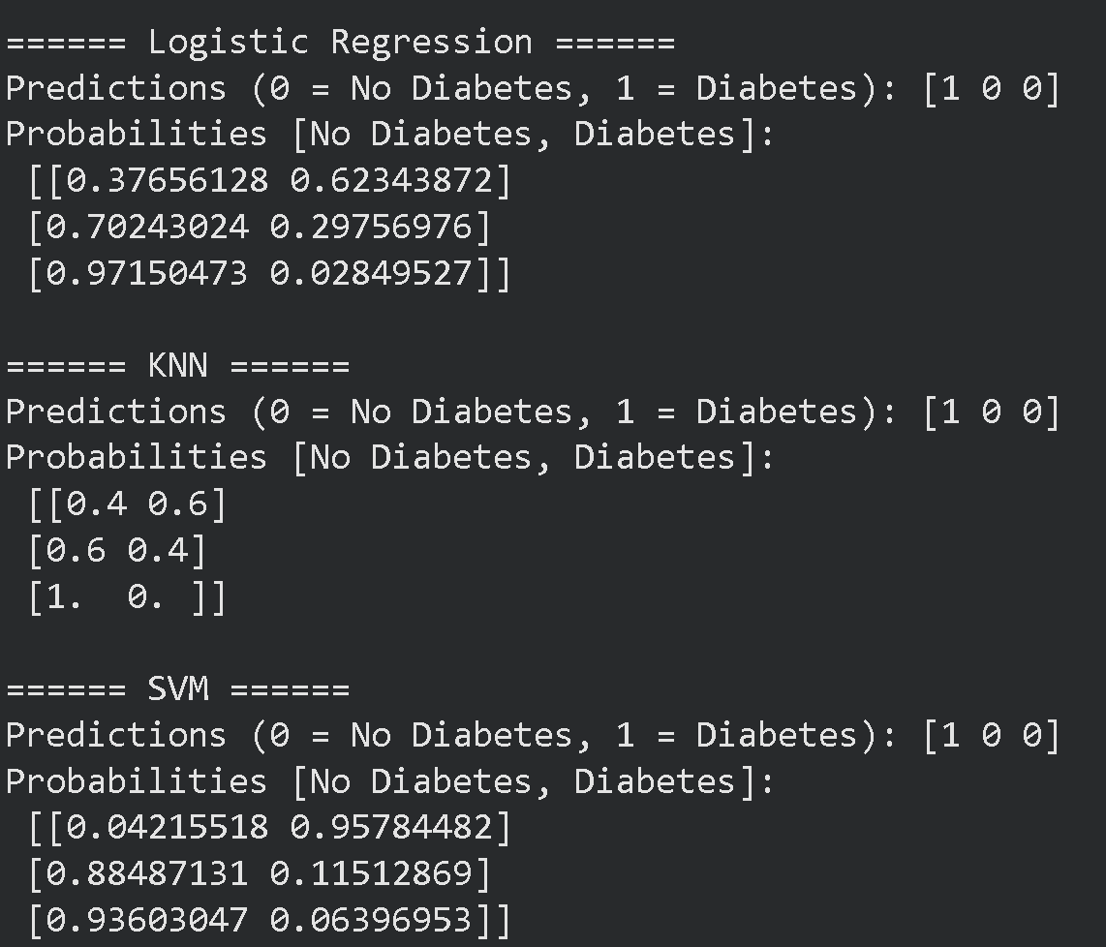
SAMPLE TEST

Slide 23
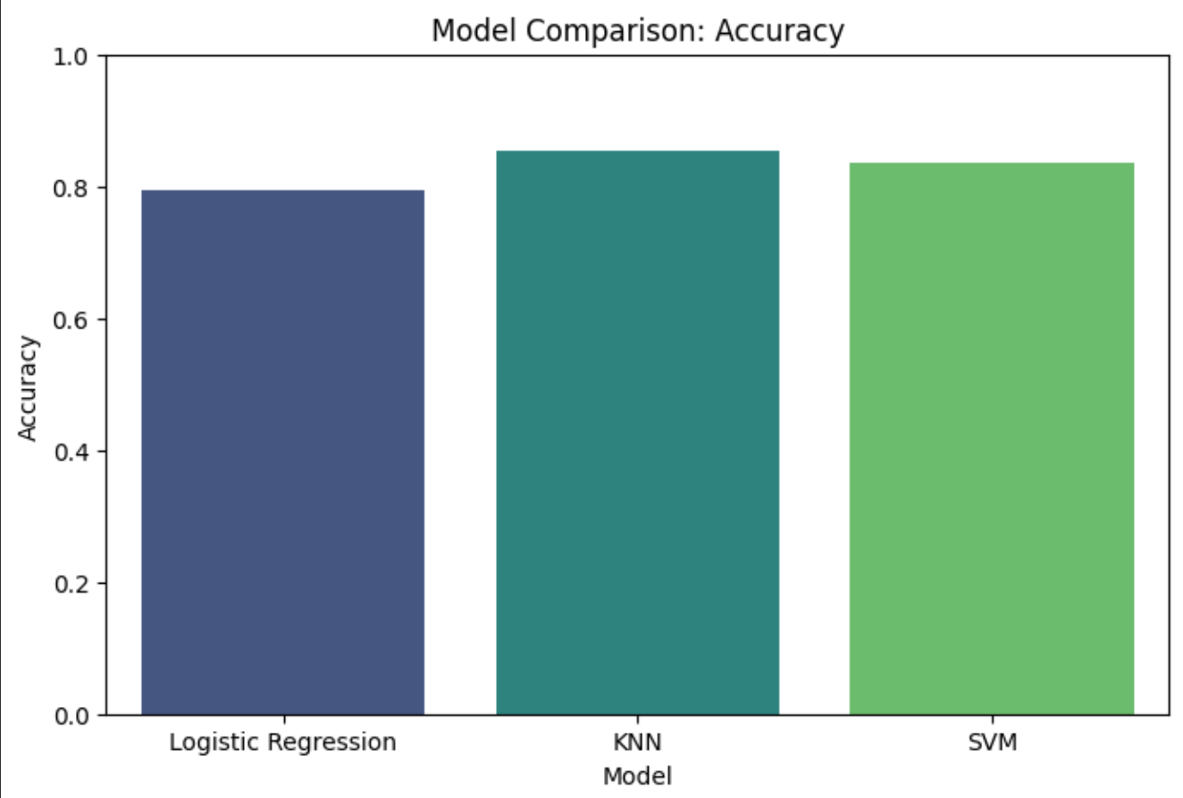
COMPARATIVE ANALYSIS

Slide 24
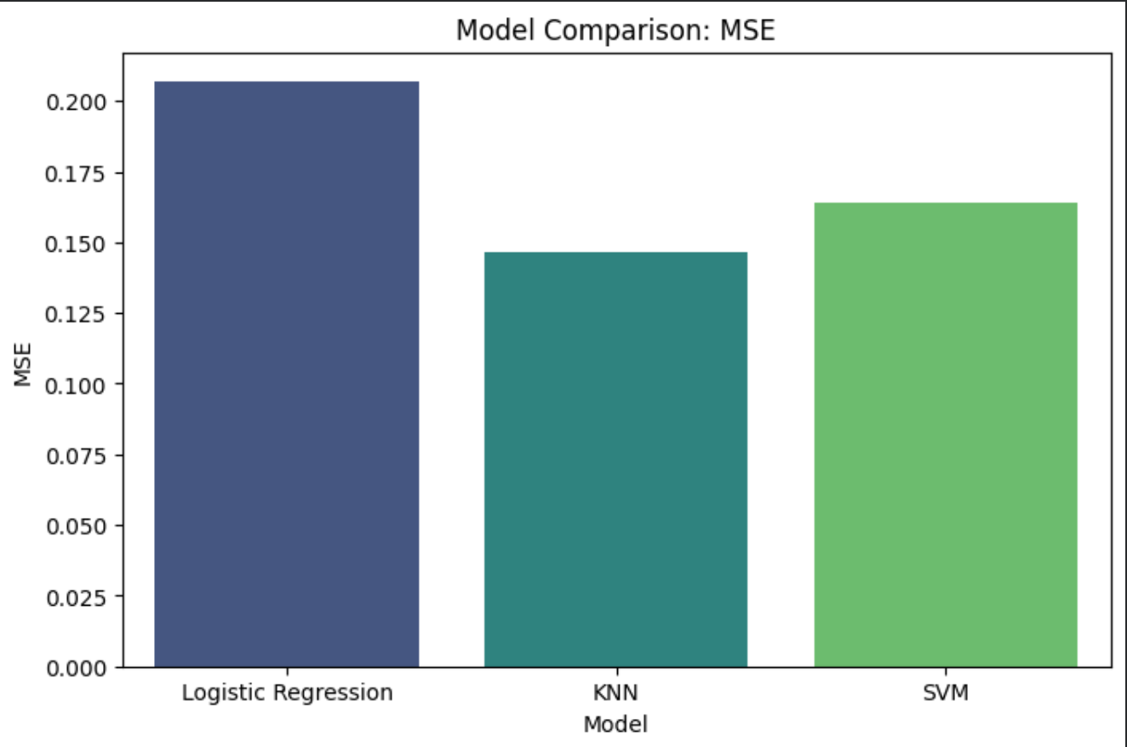
MSE ERROR ANALYSIS

Slide 25
THANK YOU

